Slide 1
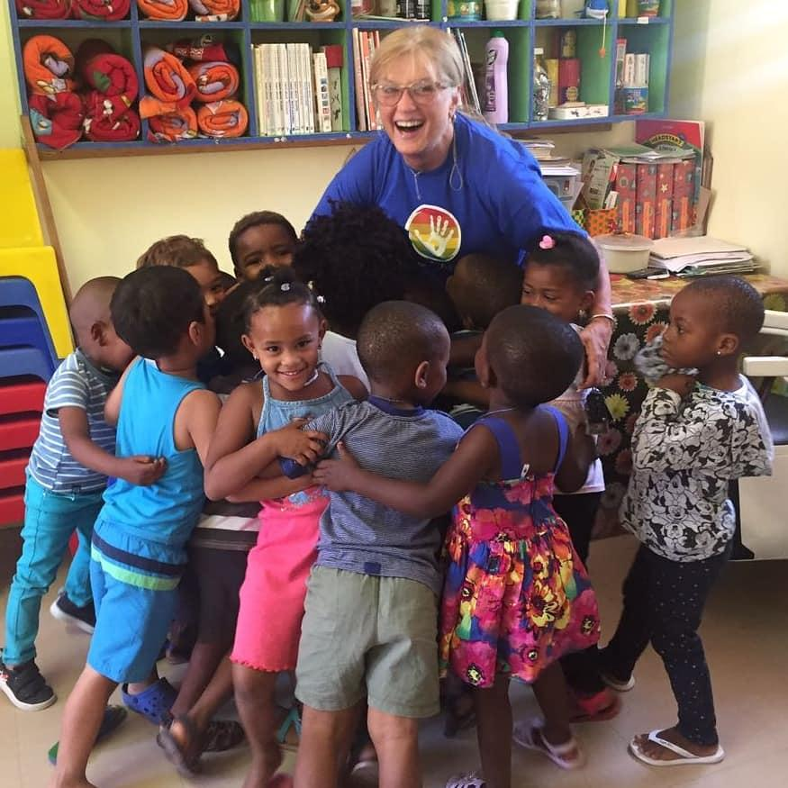

Out of Africa Children’s Foundation
About Us
Was born 15 years ago, when Kim Ferroli Highfield (founder), while facing her daughter's cancer treatment in 1996, began to help families who were also facing treatment in hospitals and had nowhere to stay or eat, so she founded a temporary safe home for these people.
The years have shown the true purpose behind each scenario, so social work began to take shape through projects aimed at needy communities in South Africa, bringing benefits and life improvements.
Currently, the organisation's projects aim to bring improvements to health, education and sport, as a strategy to rescue young people and hope for a better life.

Slide 2
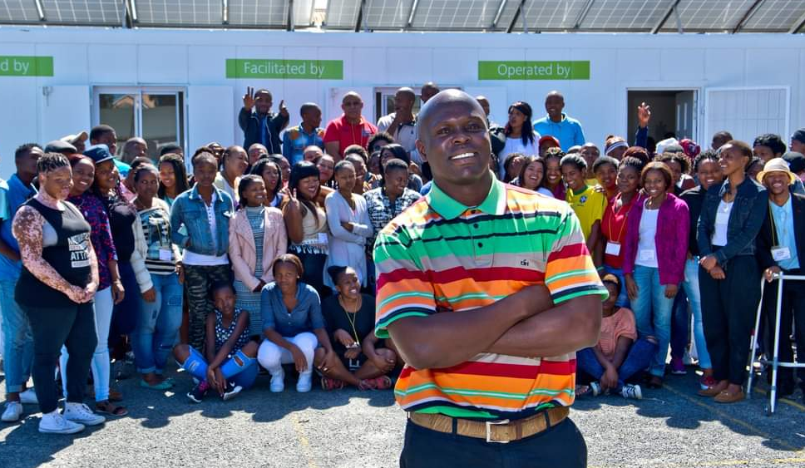
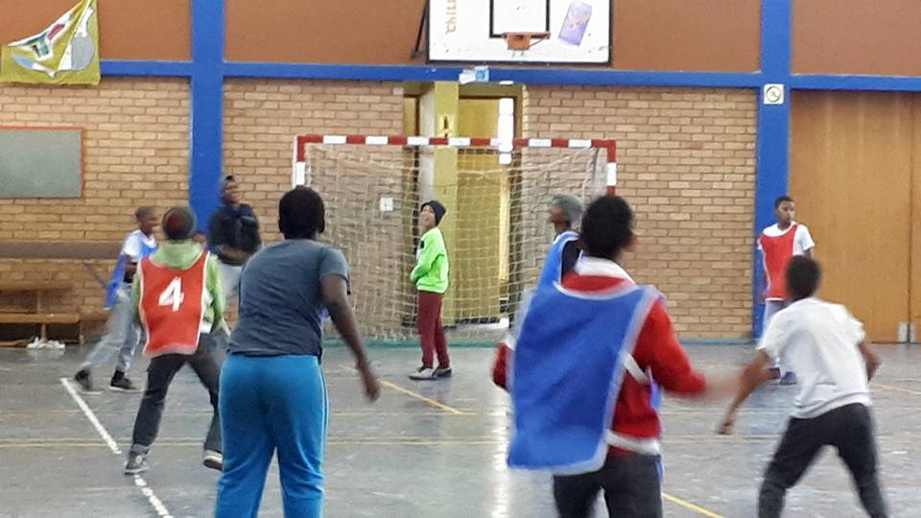
EDUCATION & SPORTS
Aftercare facility a huge hall for the youth to complete their homework and sporting programs.
BoyZ & GirlZ Empowerment project is at various different Safe Haven’s in various areas of the Cape - (Atlantis, Hout Bay, Langa, Faure/Mfuleni). The Safe Haven is a safe after-school facility with great supervision for the youth between the ages of 6 – 20 years old. This means we offers a fully operational daily activities include after-school homework support, sports, art therapy and loads of games.
We have developed many programs that are really needed in the poorer communities.
Hot nutritious meals are served, which could be the only meal the child receives. We do not do handouts BUT hand ups as they have to learn if they want something they need to work for it. Like doing a hours homework or cleaning up their community by picking up any plastic to recycle.

Slide 3
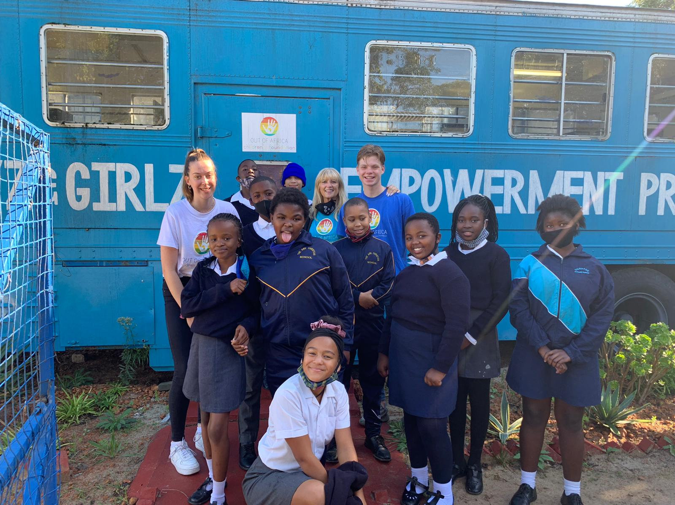
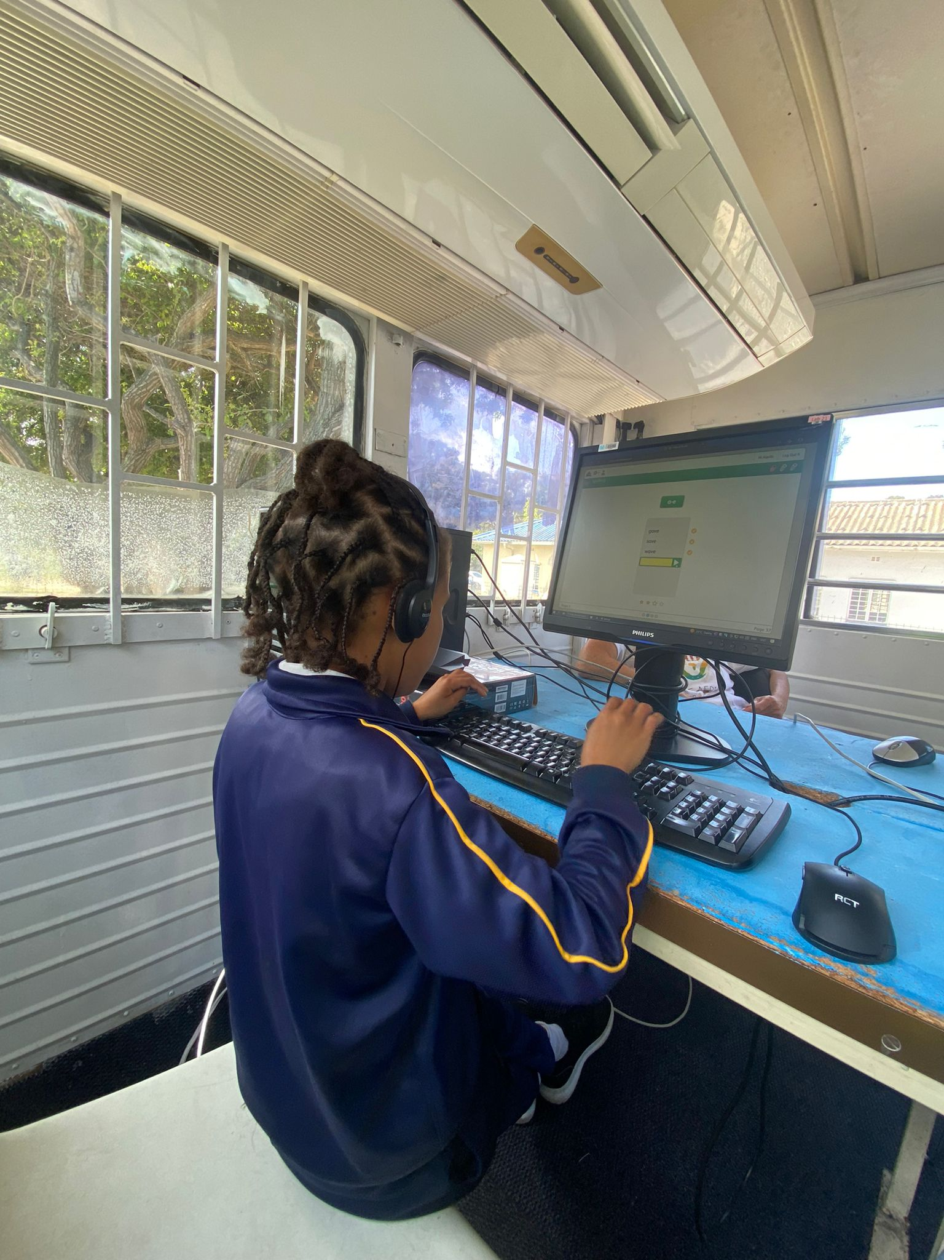
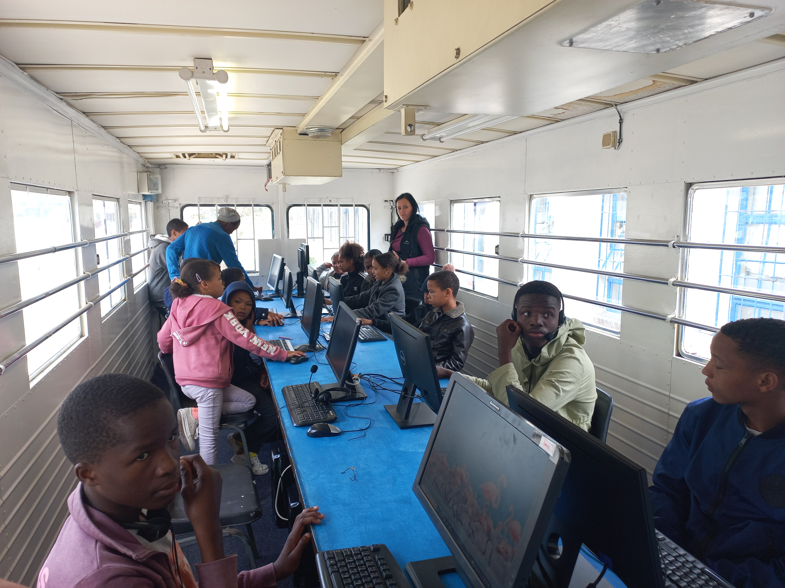
MOBILE COMPUTER CLASSROOM - Education
The “Mobile Computer Classroom” is used for farm children and young adults to do research for their projects and homework before going home in the afternoons. No more excuses as to homework not being able to be done. After these children have left for home then the children that live at the City of Refuges will be able to do their home before they have their dinner.

Slide 4
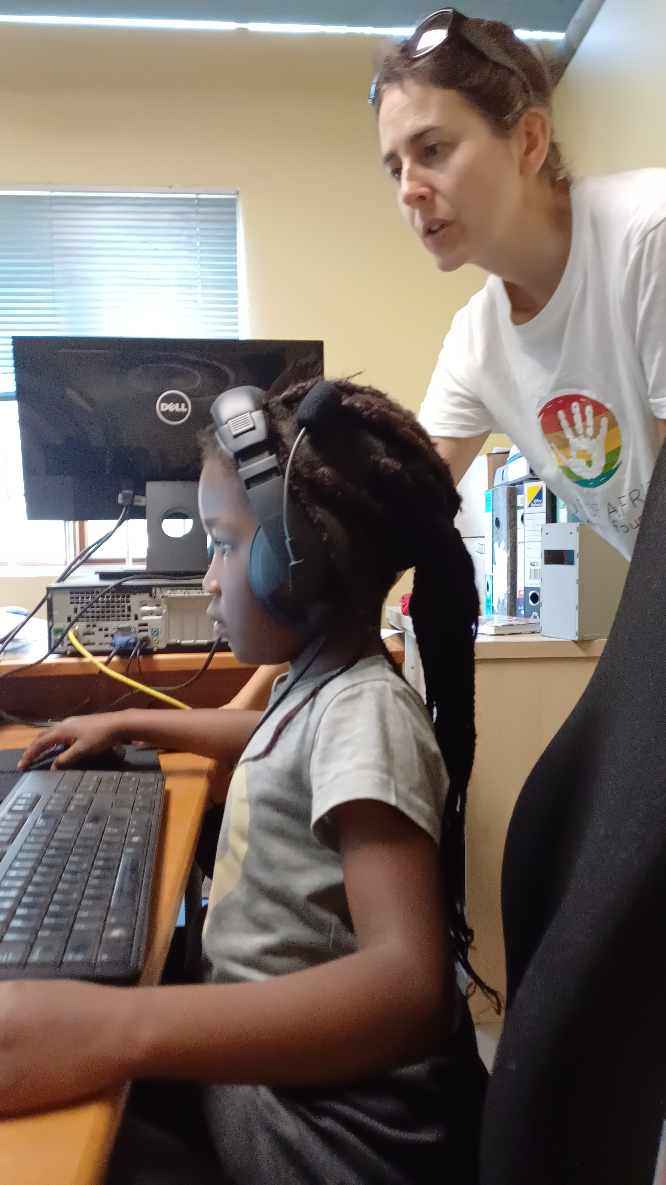
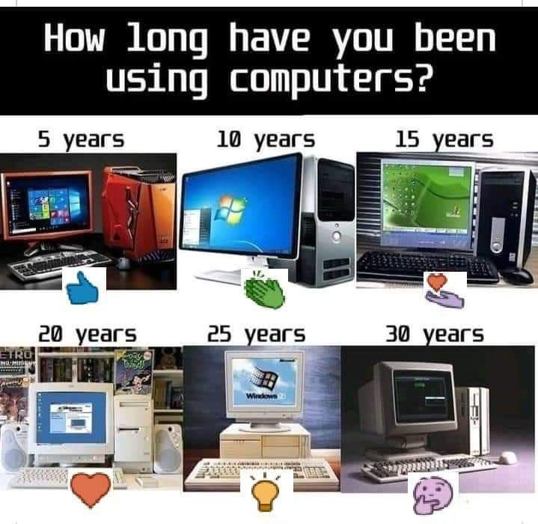
CAPE TOWN
No1 CITY for entrepreneurs in South Africa?
Data Marketing
Online Education and Training
Sports Science
Consulting Services
Cybersecurity
Healthcare Services
Art Therapy
Renewable Energy Solutions
Delivery Services
Waste Management and Recycling with Eco-Friendly Packaging

Slide 5

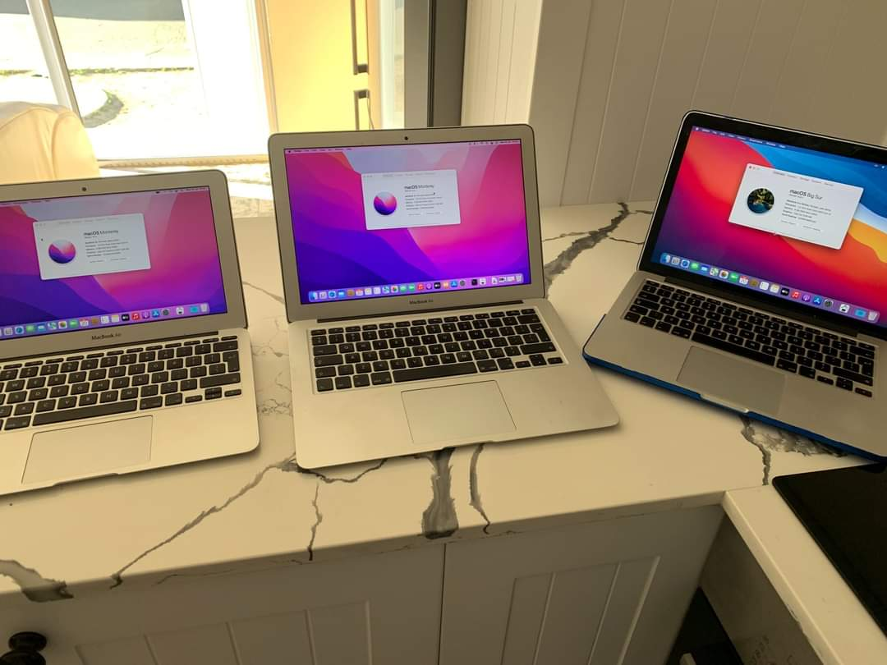
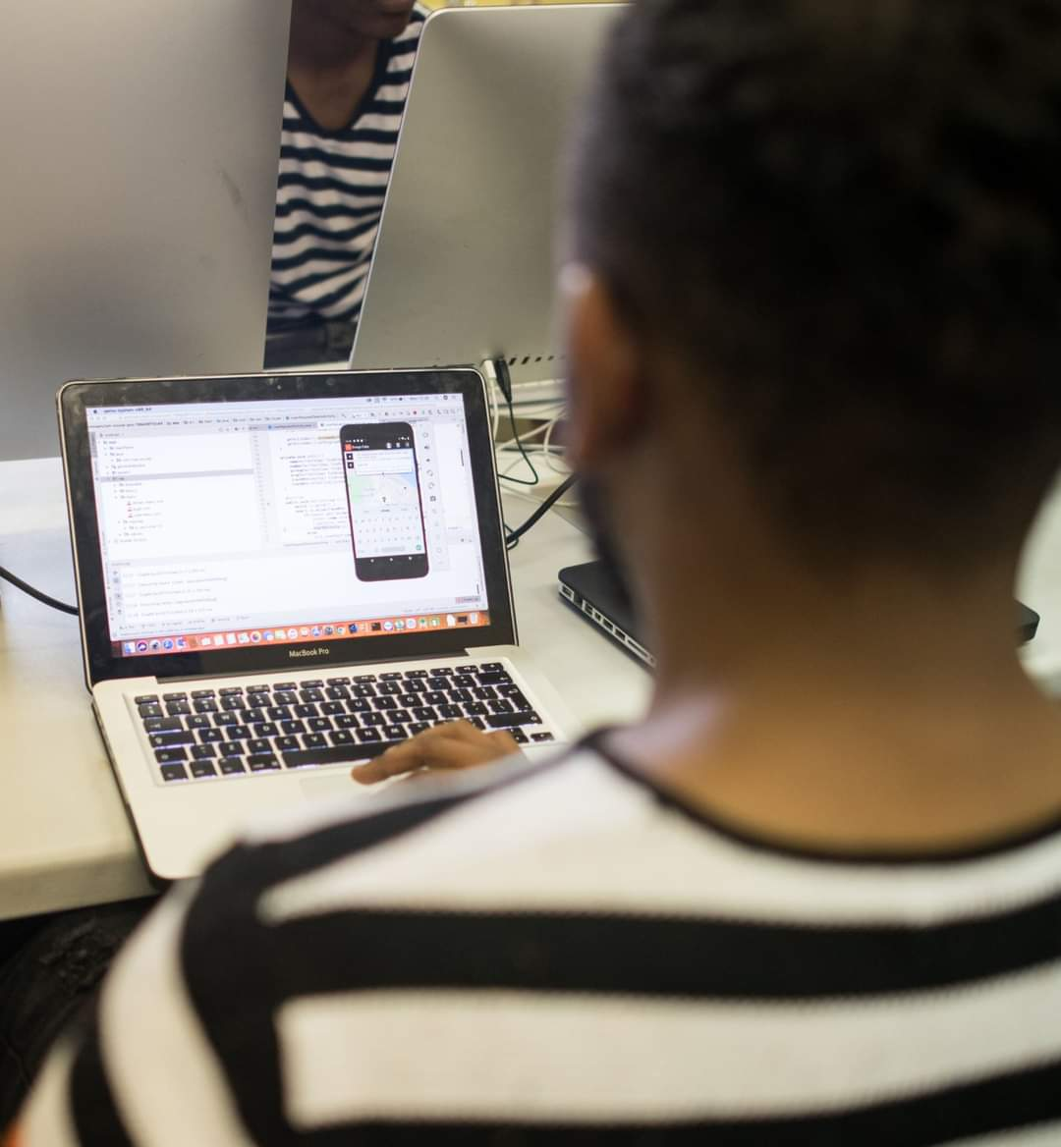
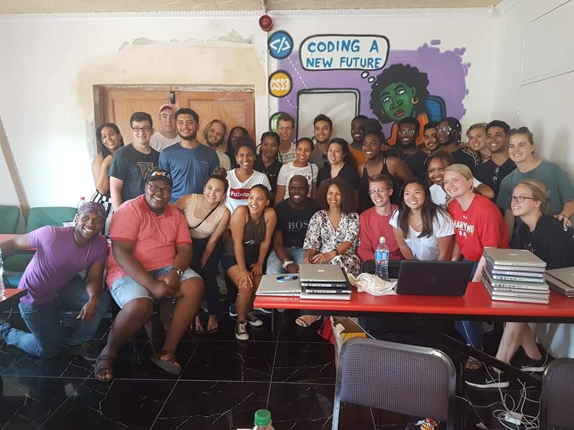
CODING PROJECT - Education
We believe the implications of this ‘revolution’ are huge – impacting education, inequality, employment and economic growth. Obviously, knowing how to code and do it well is in high demand. But it can be challenging to know where to start building your skills. Earlier in 2018 – the job of software developer was named the best job to have by U.S. News & World Report
If you know how to code, you can get a high-paying job.
Coder Dojo
CoderDojo is a global volunteer-led community of free programming clubs for young people between 7 and 17, where they can learn to code, build a website, create an app or a game, and explore technology in an informal, creative, and social environment.

Slide 6
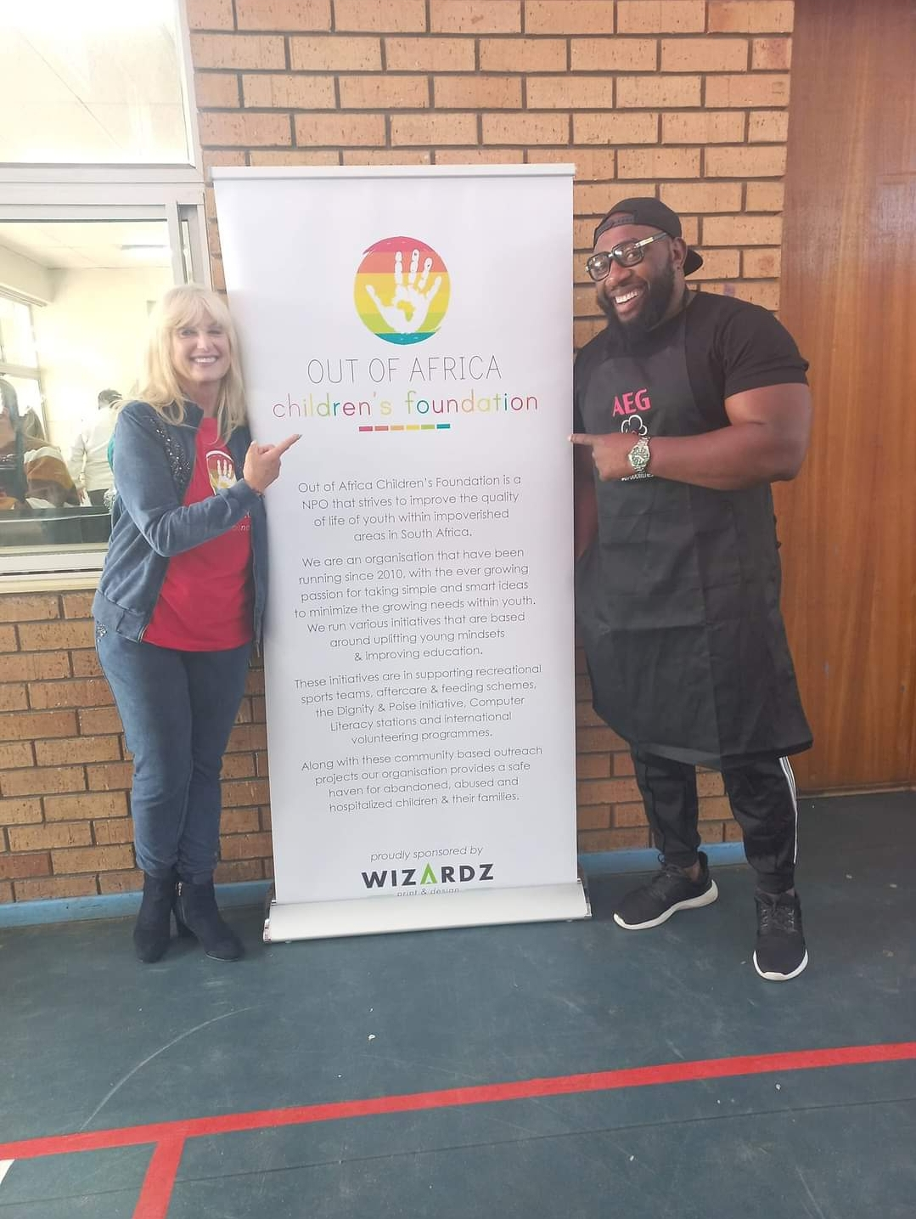
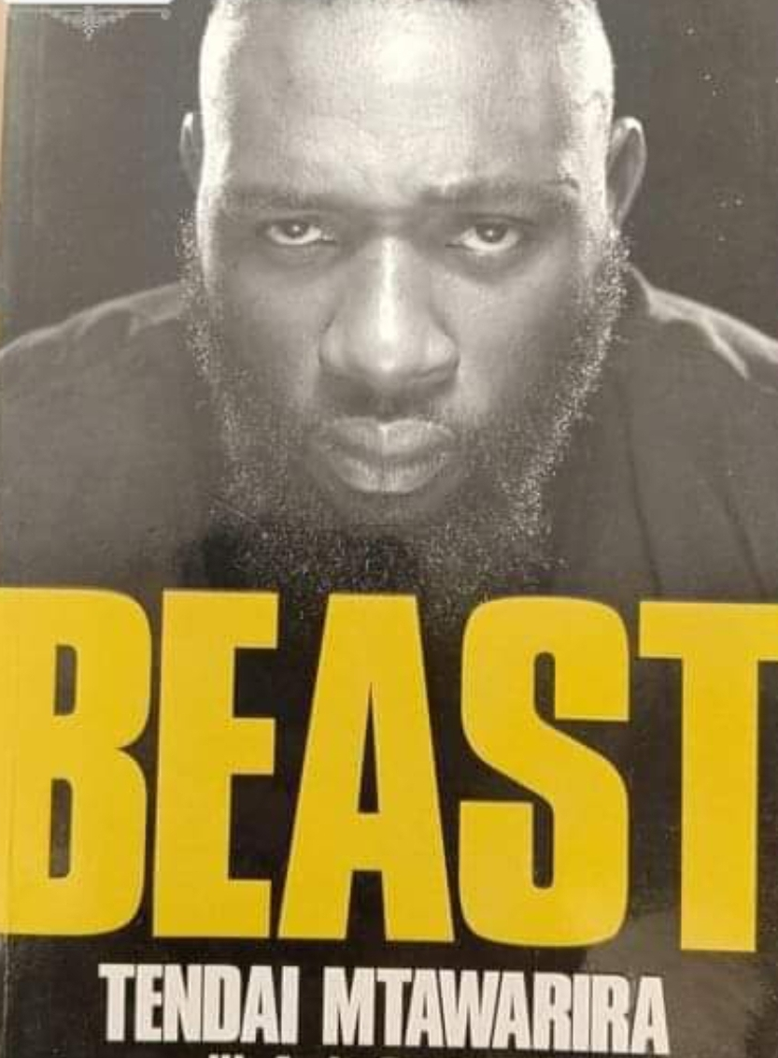
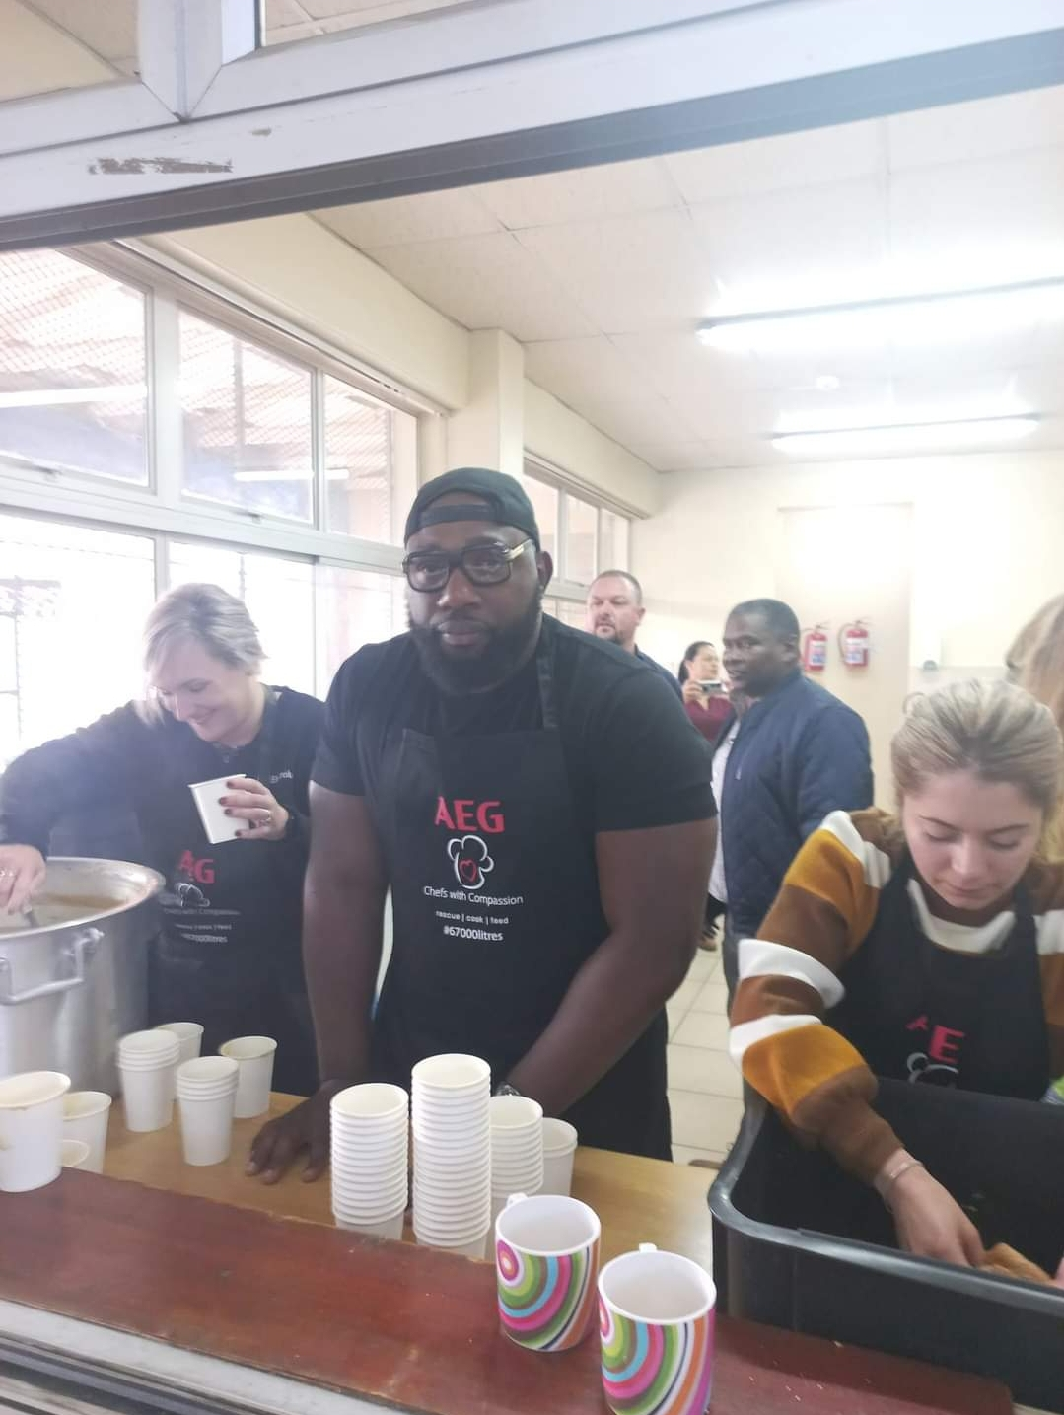
OUR PATRON THE GENTLE GIANT

Slide 7

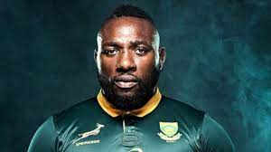

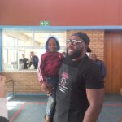
OUR PATRON – THE BEAST – TENDAI MTAWARIRA
Tendai Mtawarira is a Zimbabwean-South African retired professional rugby union player who last played for Old Glory DC in Major League Rugby and previously for the South Africa national team and the Sharks in SuperRugby. The Beast became our Patron on 18 July 2022 when he come with our sponsor,
Electrolux to join us in Atlantis for Madeba Day! What a great surprise our children and youth had when this HUGE GIANT got out of the vehicle.
He too believes in a balanced life – and has joined forces with us to help the less fortune to INSPIRE, UNITE and BUILD communities in developing the next generation of African leaders through SPORT, EDUCATION, ART, ENVIROMENT and LIFE SKILLS DEVELOPMENT

Slide 8

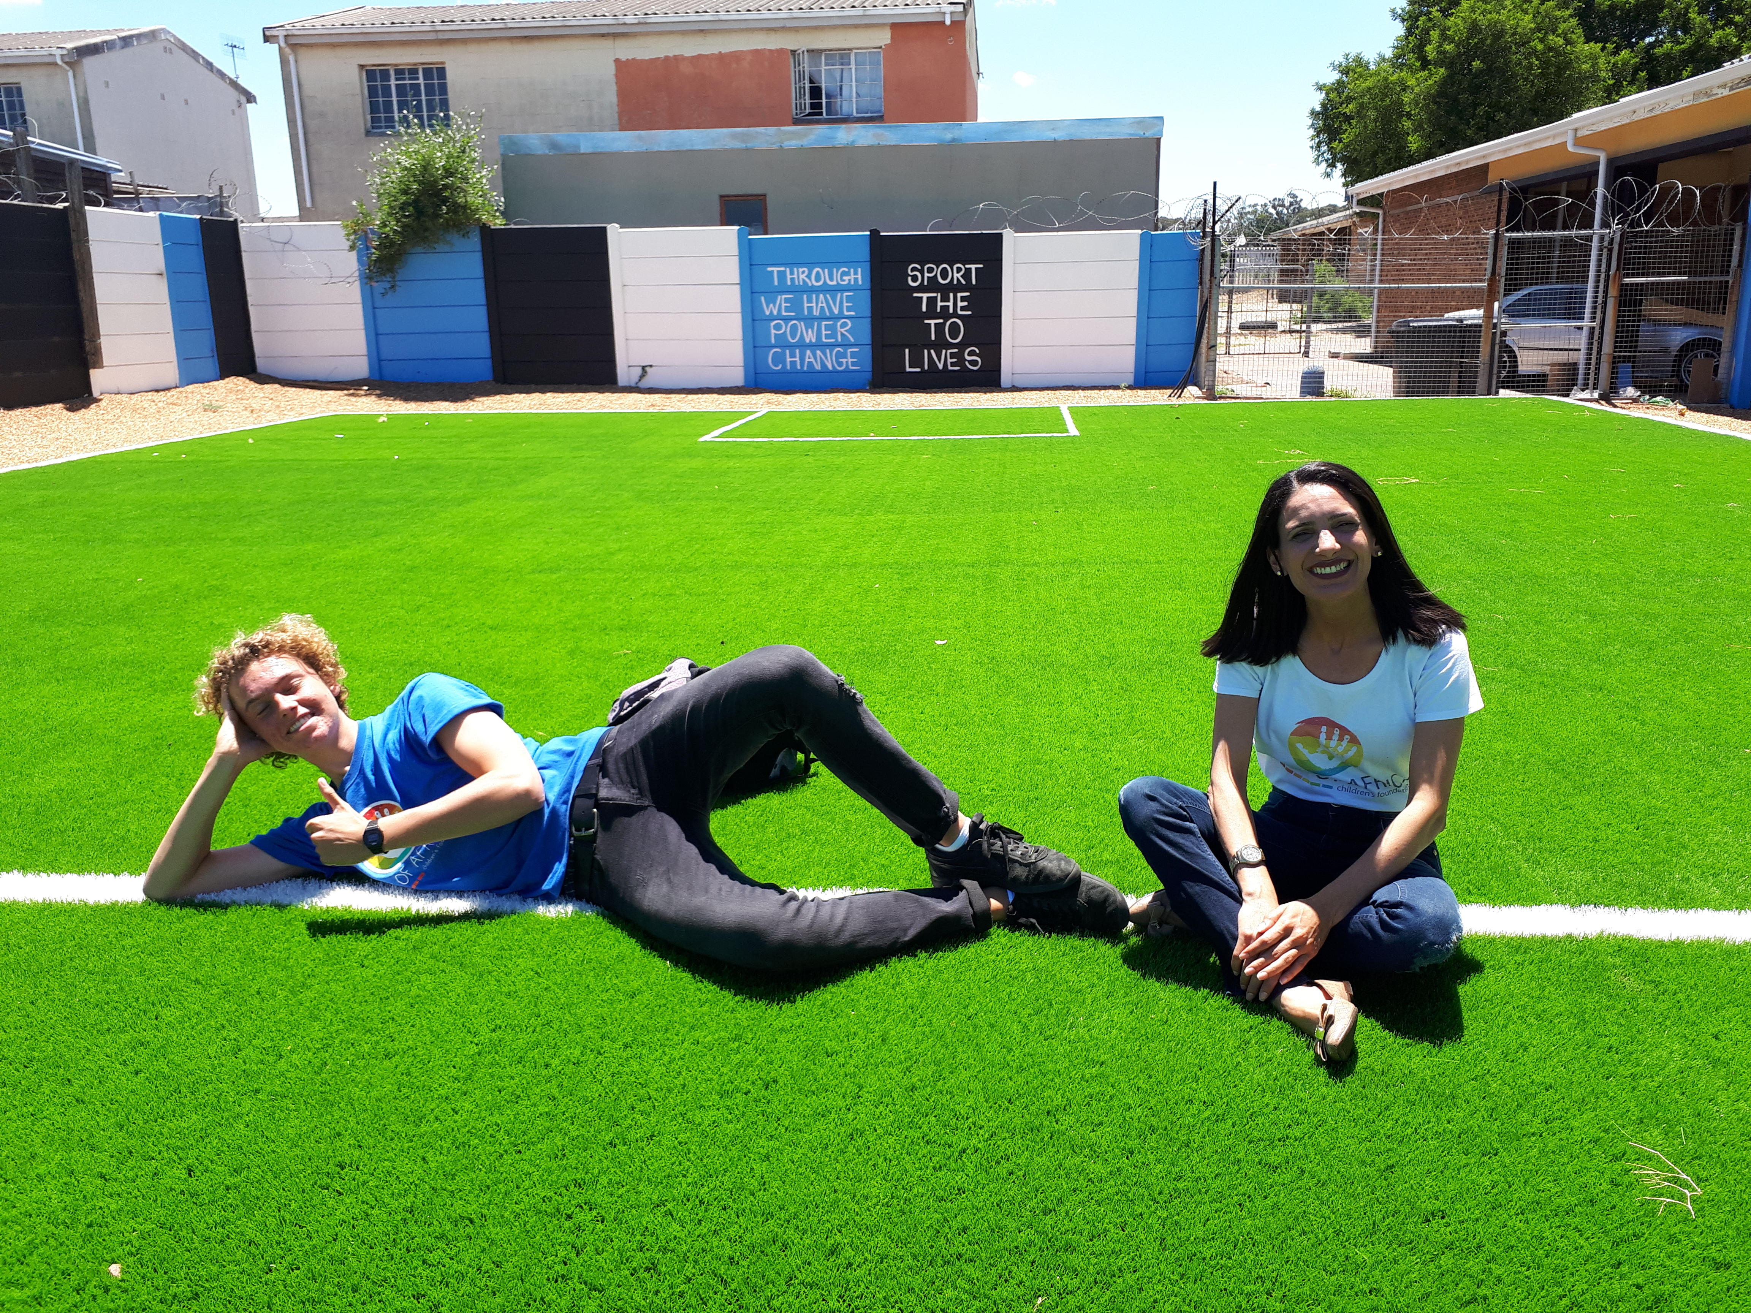
With our Partnerships we are Stronger TOGETHER !
If you have a passion for SPORTS come share this with underprivileged children. We have a variety of sports from soccer, rugby, netball and skate boarding in different areas of Cape. This way you get to meet many cultures, from Xhosa, Sutho, Zula and Afrikaans.
So come and make a difference and put sm☺les on faces ☺
Every child deserves the right to have a balanced life with an education, sport, hygiene, art and LIFE SKILLS DEVELOPMENT.
Create Safe & Supportive Environments.
Activities create awareness & involvement in projects.
Assisting large classes of children in less fortune communities.
Up-liftment of youth for they are the future !
We believe in HAND-UPS NOT HAND-OUTS.
So if children want to receive, then they need to learn to work and give back to the ENVIROMENT by cleaning up their areas collecting plastic – WANT WASTE PROJECT. In return the children will receive meals, get help with their homework and sanitary-ware for our POISE & DIGNITY PROJECT.

Slide 9
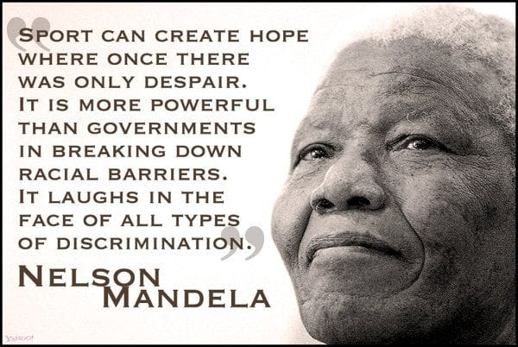
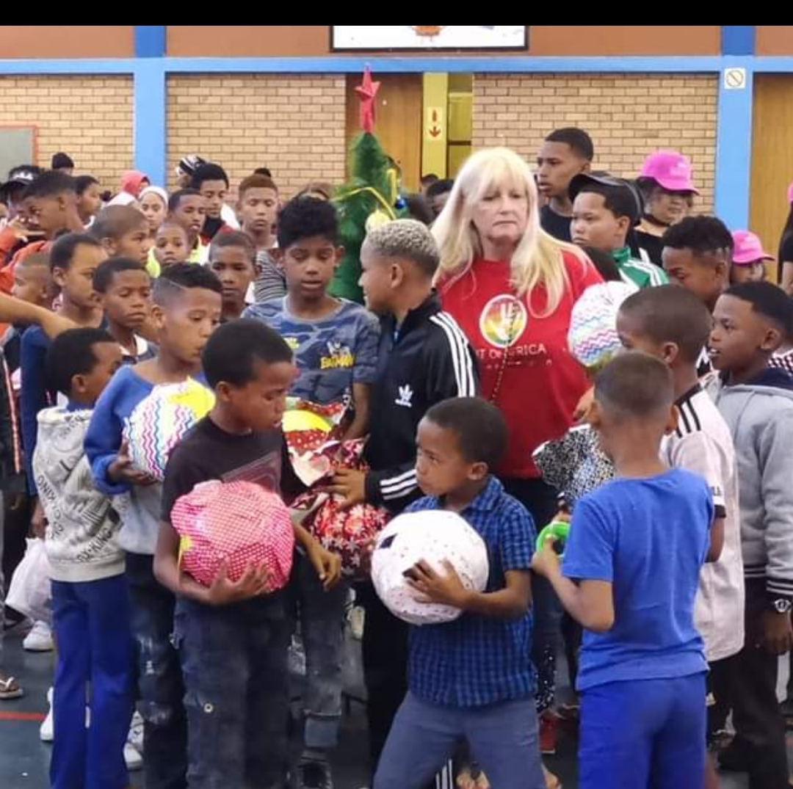
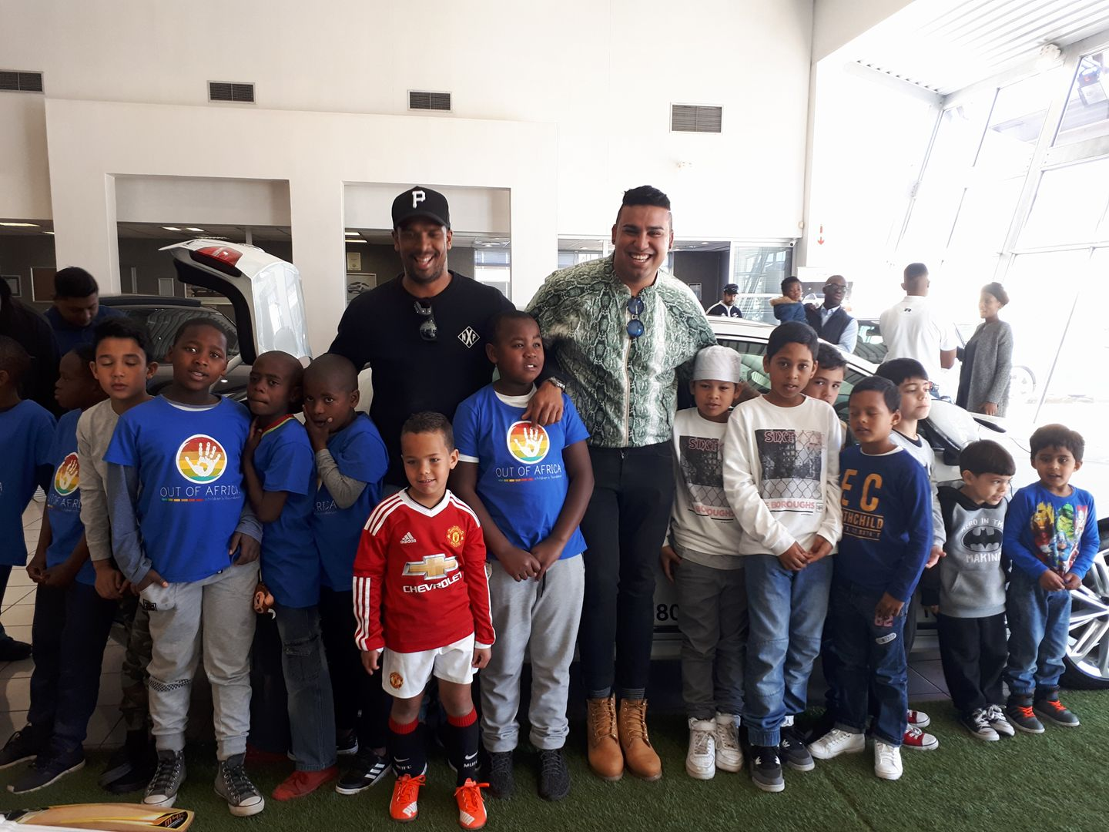
SPORT TO BALANCE LIVES – THROUGH SPORT WE HAVE THE POWER TO CHANGE LIVES ☺ Up-liftment/Community
This project gets children off the streets who don’t have afterschool supervision and provides sporting opportunities such as soccer, rugby and netball. The coach volunteers are sports men and women plus interns and volunteers from all over the world. The children participate in neighbourhood clean-ups and recycling and in return receive free coaching, sports equipment and clothing.

Slide 10
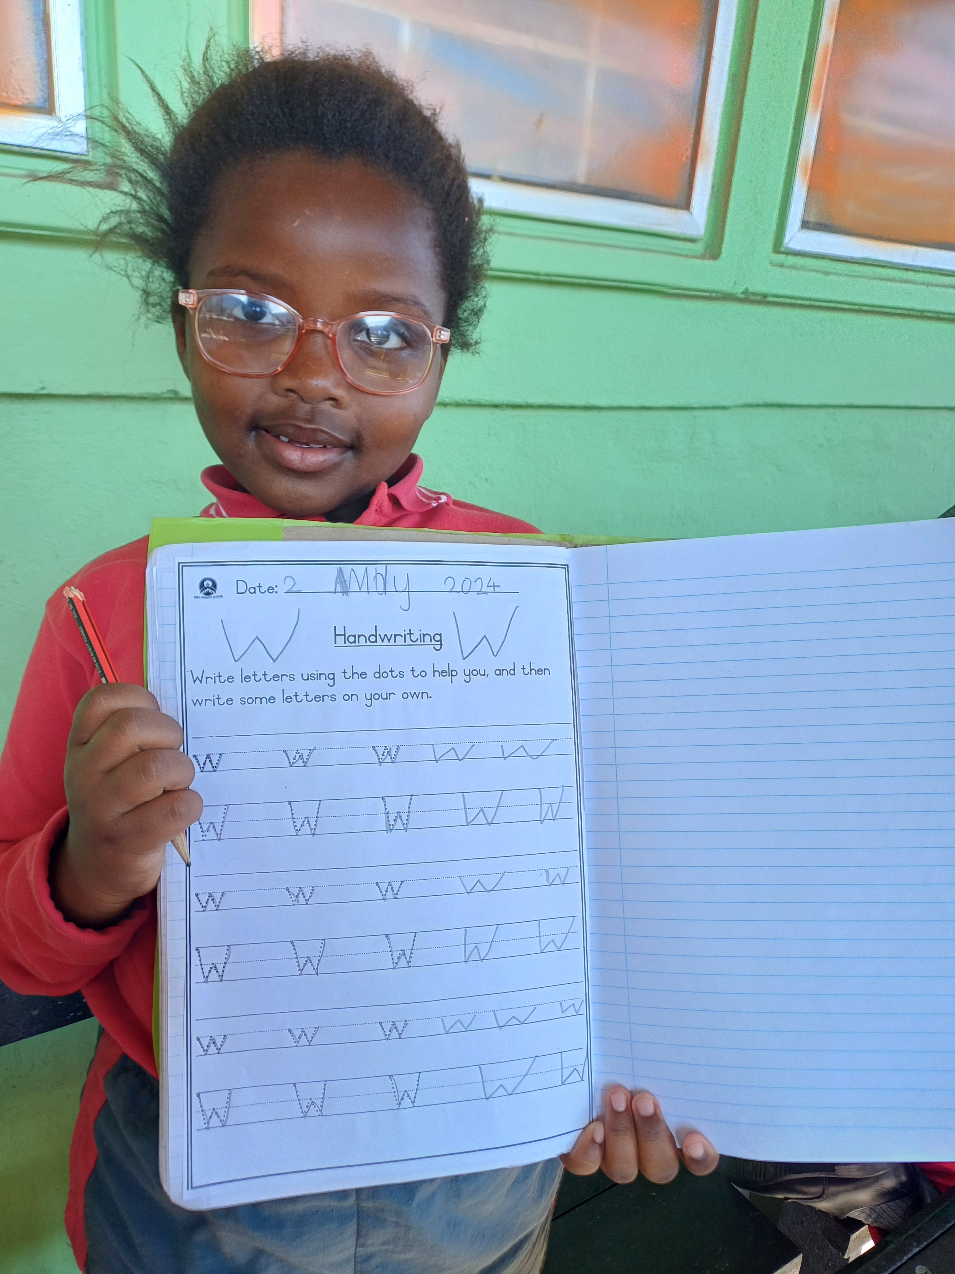
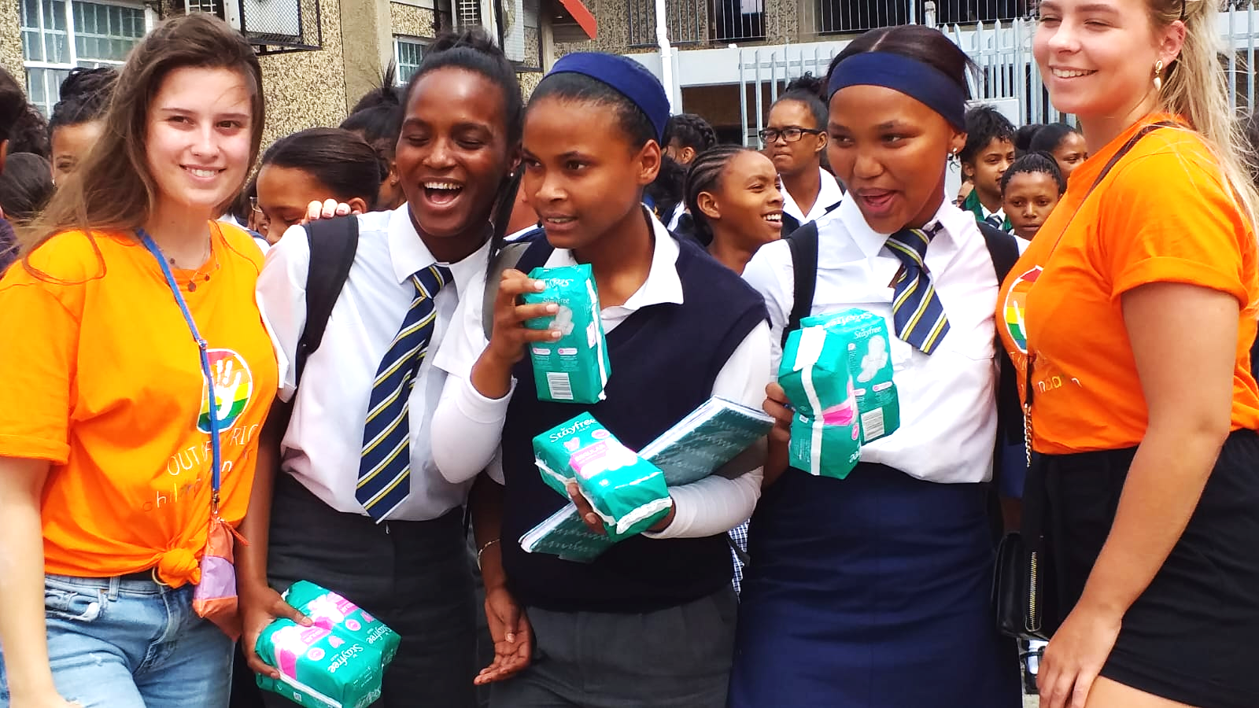
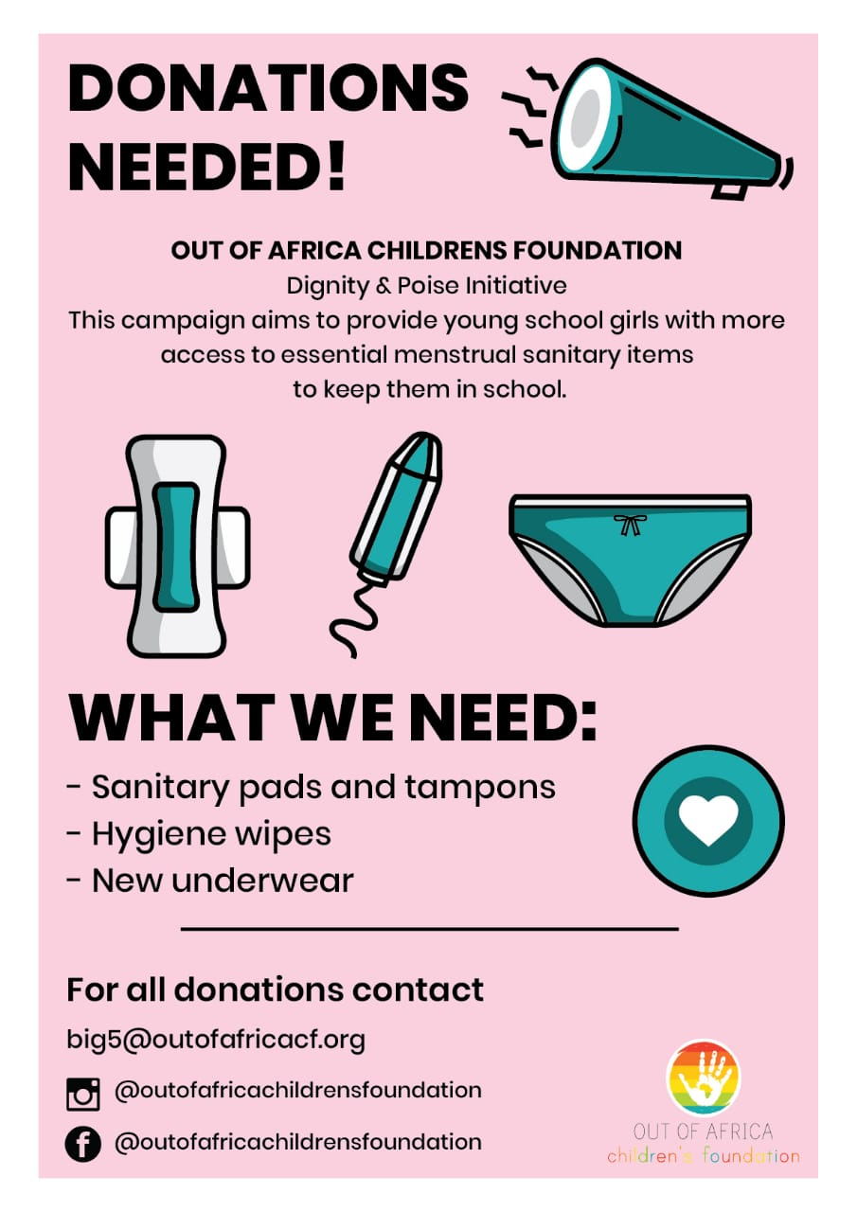
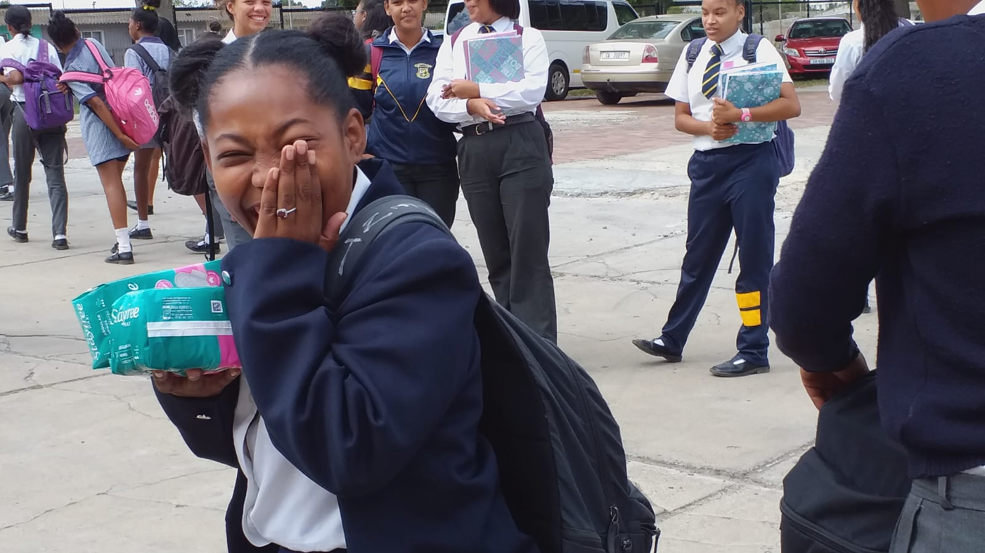
TEACHING OPPORTUNITIES /Education
English is an international language so there are plenty opportunities for interns who have done a English course from one of the many companies offering English course to assist you with your English. Then you will be able to teach our children in our various projects with the different cultures in South Africa.
Helping them with Homework in the Township of Atlantis, Hout Bay, Langa and Mfuleni . Want to make a lasting difference?
Improving Class Attendance
Dignity and Balance: Providing Support for Young Women's Hygiene so they don’t have to skip school.
We acquired this item so that all students can be covered, aiming to contribute to personal care that culminates in better women's health and, consequently, avoiding losses to academic performance.
• Actions in schools promoting access to Intimate Hygiene
• Distribution of intimate hygiene kits
• Menstrual health education
• Empowering girls to reach their full potential
• Combats student dropout during their menstrual period

Slide 11
DIGNITY & POISE INITIATIVE (sanitary-ware)Hygiene/Education Improving Class Attendance
Dignity and Balance: Providing Support for Young Women's Hygiene so they don’t have to skip school.
We acquired this item so that all students can be covered, aiming to contribute to personal care that culminates in better women's health and, consequently, avoiding losses to academic performance.
• Actions in schools promoting access to Intimate Hygiene
• Distribution of intimate hygiene kits
• Menstrual health education
• Women’s stories of impact and success
• Empowering girls to reach their full potential
• Combats student dropout during their menstrual period

Slide 12
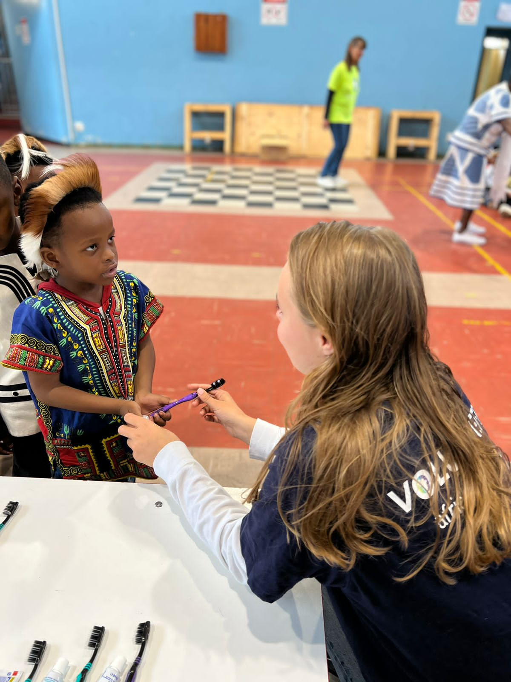
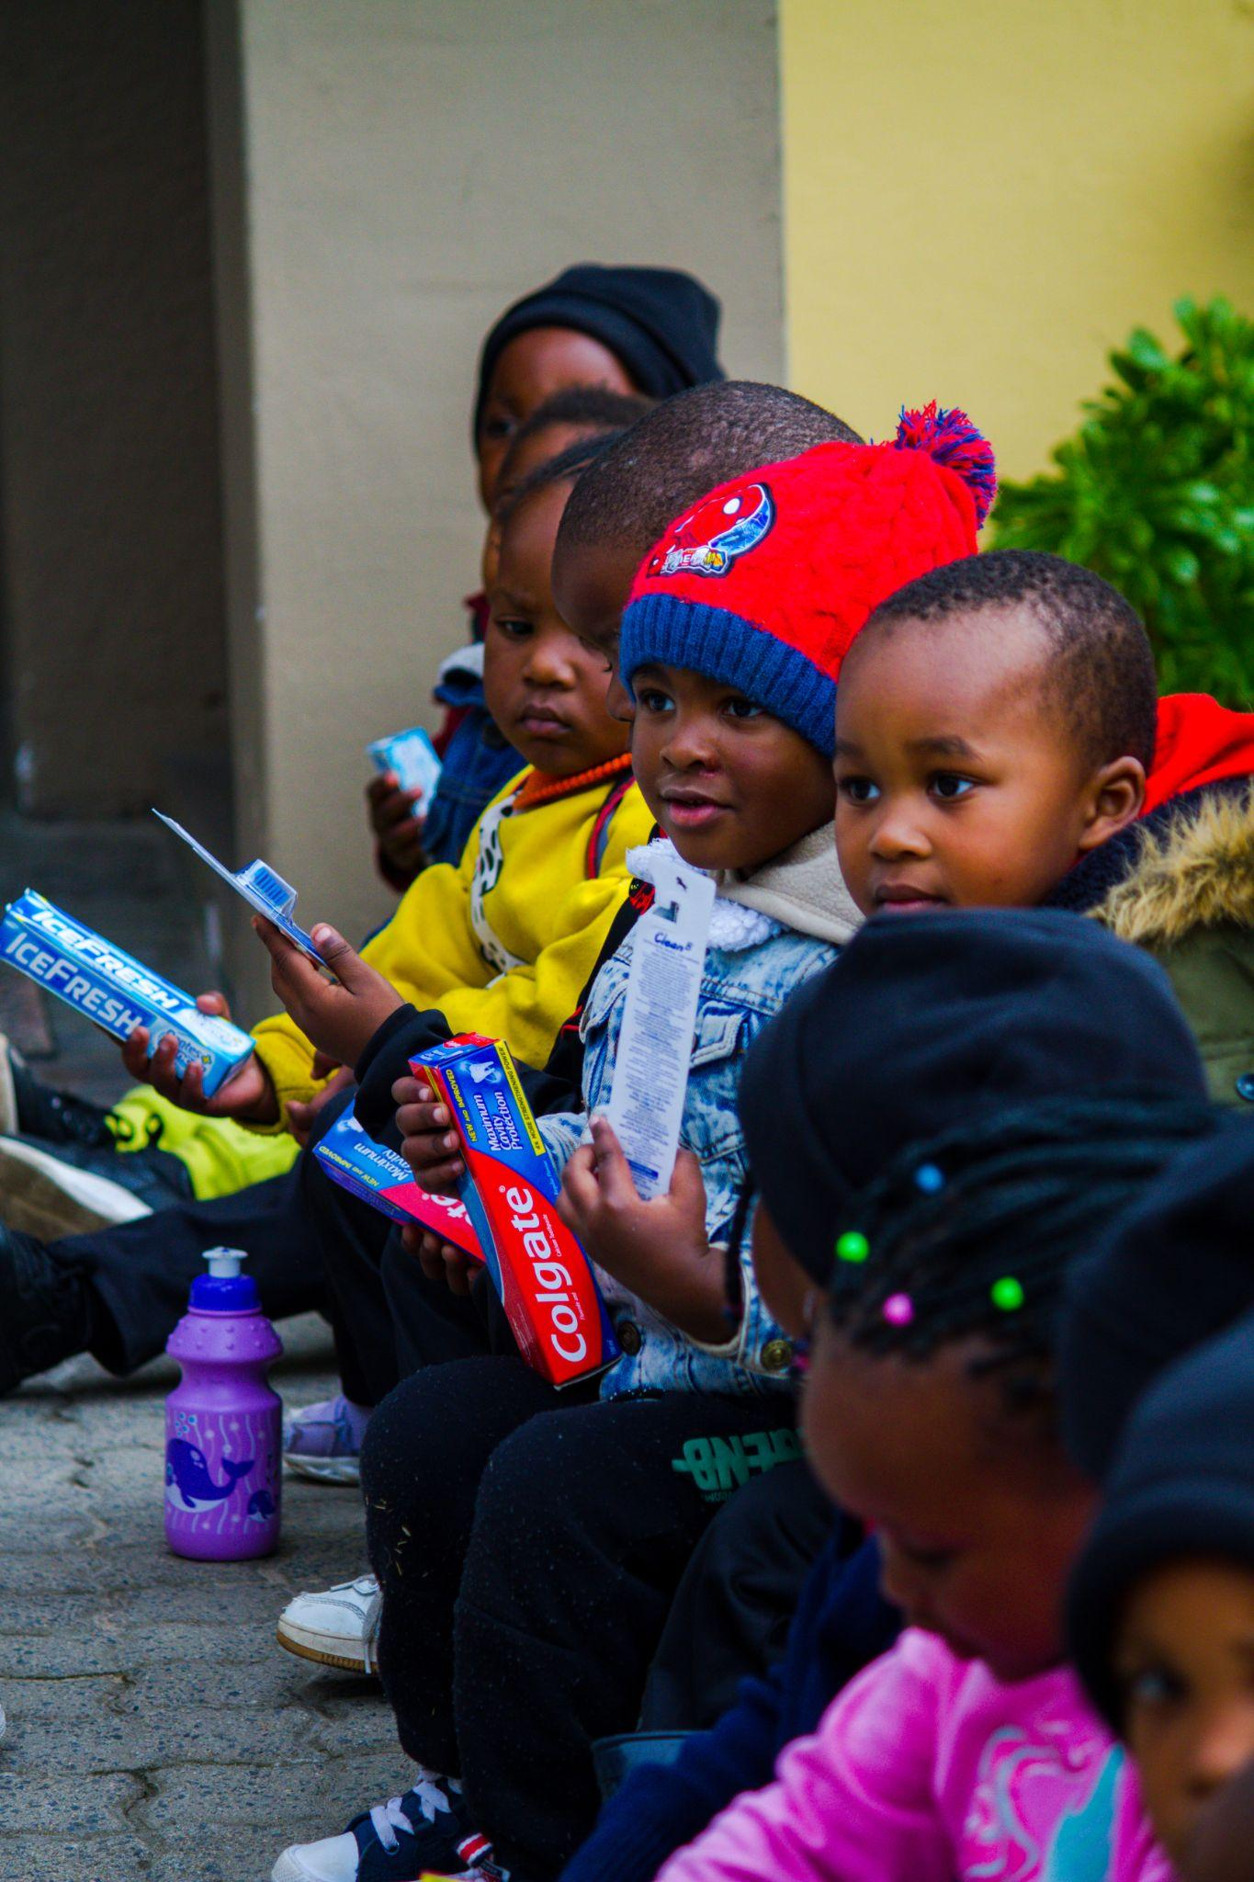
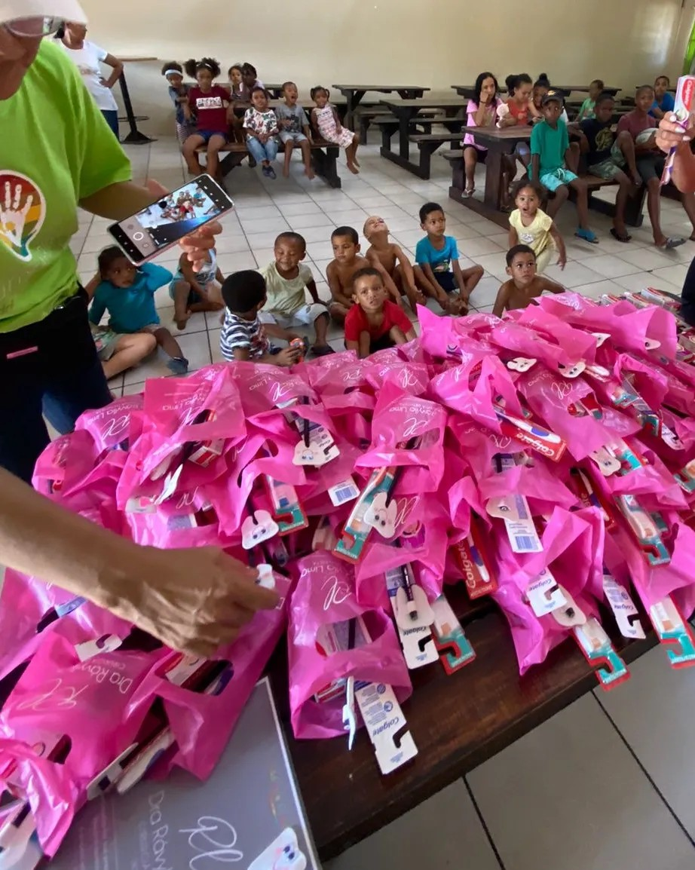
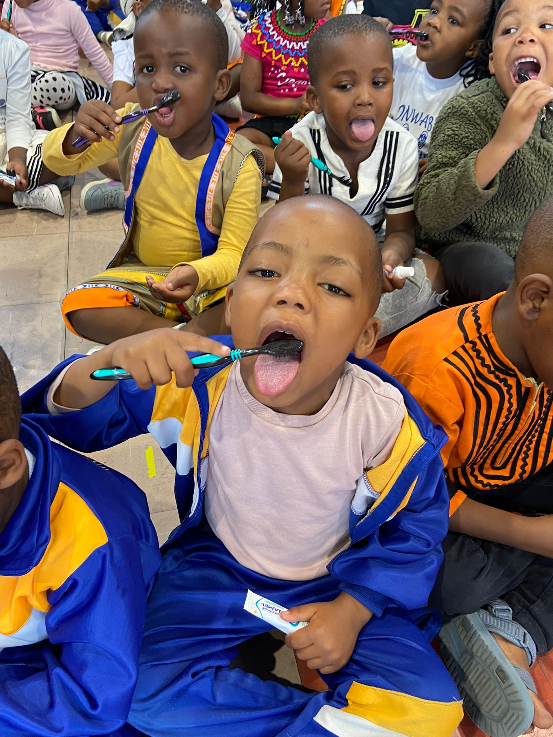
BRAZIAN BRIGHTER SM☺LES Oral Hygiene: Smiles for Brighter Futures The link between oral health and overall well-being Our oral hygiene initiatives: • Workshops and Dental Health Check-ups • Provision of toothbrushes and toothpaste • Oral health campaigns

Slide 13
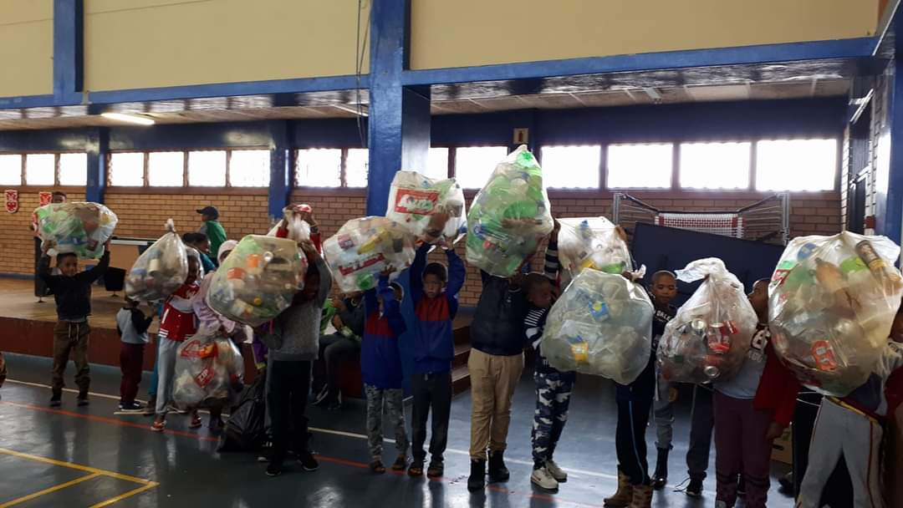
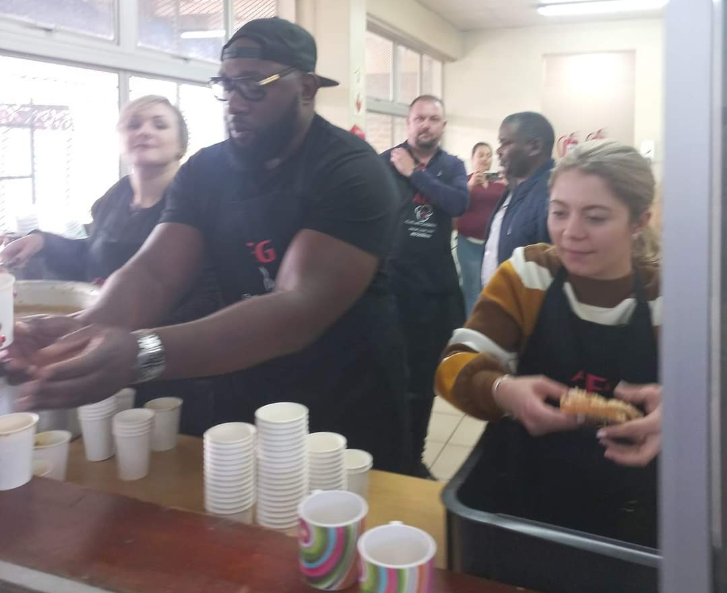
WANT WASTE – Community & Environment
WE BELIEVE IN HAND-UPS NOT HAND-OUTS
WANT WASTE
Plastics cannot be burned away or broken down, and this calls for serious problems in the environment, including land, air, water and food pollution. The children need to collect all the plastic laying around in their area and return to our BoyZ & GirlZ Empowerment base, in order to receive a healthy meal.
This may be the only meal they have for their day !

Slide 14
Contact Information
+27 72 430 1818
big5@outofafricacf.org
outofafrica.org
@outofafricafoundation
Our Mission
We are a foundation dedicated to enhancing the lives of underprivileged and ailing children in South Africa, striving to uplift their quality of life. Our primary focus is on delivering love, attention, education, sports, hygiene, recreation, and essential needs to children and youth in a secure environment, fostering genuine development and growth.
Our Mission
AFRICAN JEWEL VOLUNTEERING FOUNDATION is a NON-PROFIT ORGANISATION (NPO)that creates an environment where we offer international volunteers with an opportunity to provide social assistance and innovative ideas to enrich our children’s well-being in South Africa and similarly, providing our volunteers with a memorable experience of the various cultures of our Rainbow Nation.”

